Slide 2
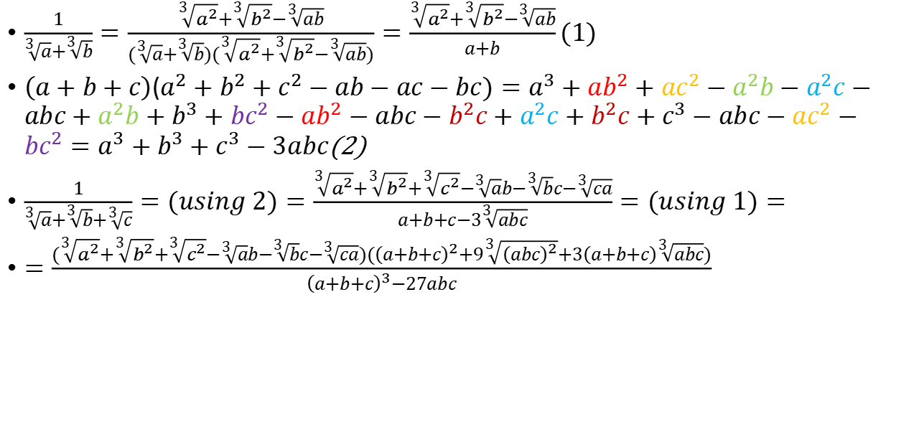

$$Rationalize \frac{1}{\sqrt[3]{a}+\sqrt[3]{b}+\sqrt[3]{c}}$$
$\frac{1}{\sqrt[3]{a}+\sqrt[3]{b}}=\frac{\sqrt[3]{a^{2}}+\sqrt[3]{b^{2}}−\sqrt[3]{ab}}{(\sqrt[3]{a}+\sqrt[3]{b})(\sqrt[3]{a^{2}}+\sqrt[3]{b^{2}}−\sqrt[3]{ab})}=\frac{\sqrt[3]{a^{2}}+\sqrt[3]{b^{2}}−\sqrt[3]{ab}}{a+b}(1)$
$\left(a+b+c\right)$($a^{2}+b^{2}+c^{2}−ab−ac−bc)=a^{3}+ab^{2}+{ac}^{2}−a^{2}b−a^{2}c−abc+a^{2}b+b^{3}+{bc}^{2}−ab^{2}−abc−b^{2}c+a^{2}c+b^{2}c+c^{3}−abc−ac^{2}−bc^{2}=a^{3}+b^{3}+c^{3}−3abc$(2)
$\frac{1}{\sqrt[3]{a}+\sqrt[3]{b}+\sqrt[3]{c}}=(using 2)=\frac{\sqrt[3]{a^{2}}+\sqrt[3]{b^{2}}+\sqrt[3]{c^{2}}−\sqrt[3]{a}b−\sqrt[3]{b}c−\sqrt[3]{ca}}{a+b+c−3\sqrt[3]{abc}}=(using 1)=$
$=\frac{(\sqrt[3]{a^{2}}+\sqrt[3]{b^{2}}+\sqrt[3]{c^{2}}−\sqrt[3]{a}b−\sqrt[3]{b}c−\sqrt[3]{ca})({\left(a+b+c\right)}^{2}+9\sqrt[3]{{\left(abc\right)}^{2}}+3\left(a+b+c\right)\sqrt[3]{abc})}{{\left(a+b+c\right)}^{3}−27abc}$

Slide 3
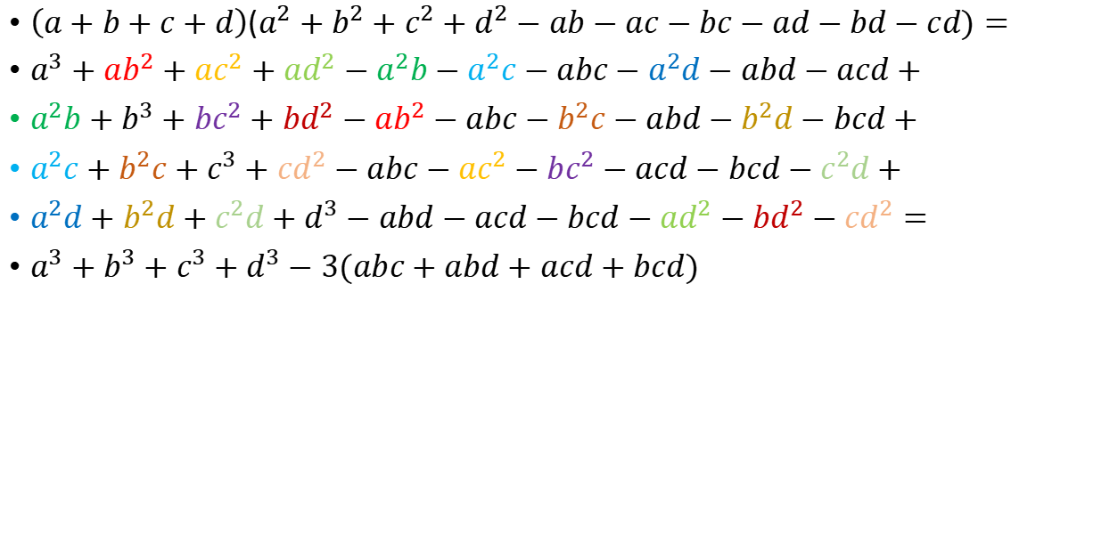

$$Rationalize \frac{1}{\sqrt[3]{a}+\sqrt[3]{b}+\sqrt[3]{c}+\sqrt[3]{d}}$$
$\left(a+b+c+d\right)$($a^{2}+b^{2}+c^{2}+d^{2}−ab−ac−bc−ad−bd−cd)=$
$a^{3}+ab^{2}+{ac}^{2}+ad^{2}−a^{2}b−a^{2}c−abc−a^{2}d−abd−acd+$
$a^{2}b+b^{3}+{bc}^{2}+{bd}^{2}−ab^{2}−abc−b^{2}c−abd−b^{2}d−bcd+$
$a^{2}c+b^{2}c+c^{3}+cd^{2}−abc−ac^{2}−bc^{2}−acd−bcd−c^{2}d+$
$a^{2}d+b^{2}d+c^{2}d+d^{3}−abd−acd−bcd−ad^{2}−bd^{2}−cd^{2}=$
$a^{3}+b^{3}+c^{3}+d^{3}−3(abc+abd+acd+bcd)$

Slide 4

Tricky Substitue number
$x^{2}+6x−2=0$; $x^{2}+\frac{12}{x}−?$
$2=x^{2}+6x$
$12=6x^{2}+36x$
$x^{2}+\frac{12}{x}=x^{2}+\frac{6x^{2}+36x}{x}=x^{2}+6x+36=x^{2}+6x−2+36=36$

Slide 5

Polynomial substitotuion trick
$a^{3}+4a=8$
find : $a^{7}+64a^{2}$
ideas: $a^{7}=aa^{6}=a{\left(a^{3}\right)}^{2},also look for 64 : ir is 4∗8∗2$
${\left(a^{3}\right)}^{2}$=${\left( 8−4a\right)}^{2}=64−64a+16a^{2}$
$a^{7}=64a−64a+16a^{3}$
$a^{7}+64a=64a+16a^{3}=16(a^{3}+4a)=16∗8$

Slide 6

Middle substitution
$\frac{1}{x+4}+\frac{1}{x+5}+\frac{1}{x+6}+\frac{1}{x+7}=0$
middle sub: x+5.5 = t
$\frac{1}{t−1.5}+\frac{1}{t−0.5}+\frac{1}{t+0.5}+\frac{1}{t+1.5}=0$
group first to last:
$(\frac{1}{t−1.5}+\frac{1}{t+1.5}) +(\frac{1}{t−0.5}+\frac{1}{t+0.5})=0$
$\frac{2t}{t^{2}−{1.5}^{2}}+\frac{2t}{t^{2}−{0.5}^{2}}=0$
t = 0 or :
$t^{2}−{1.5}^{2}$=${−(t}^{2}−{0.5}^{2})$
2$t^{2}$=2.5;
t=$±\sqrt{1.25}$

Slide 7

a$u^{2}$ + buv + c$v^{2}$=0
divide on v^2 to make it trivial quadratic equasion:
a$a{\left(\frac{u}{v}\right)}^{2}+b\frac{u}{v}+c=0$
example:
$6x^{2}+7x\sqrt{x+1}−24\left(x+1\right)=0$
$6{\left(\frac{x}{\sqrt{x+1}}\right)}^{2}+7\frac{x}{\sqrt{x+1}}−24 = 0$

Slide 8
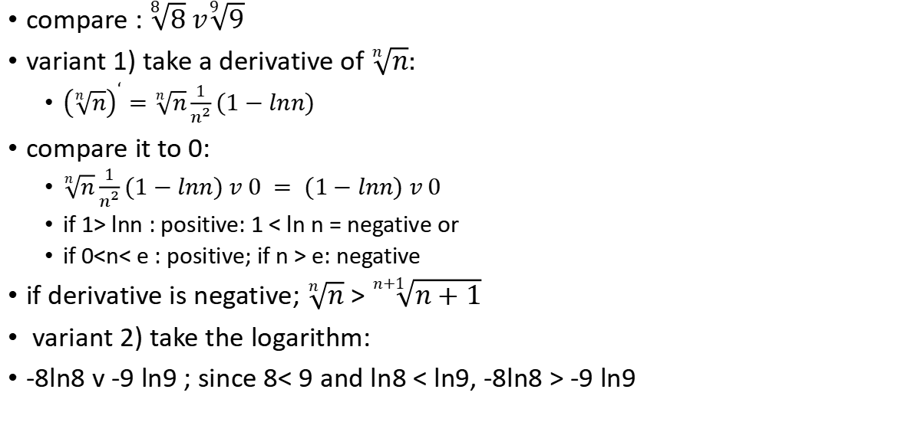
Exponent comparation:
compare : $\sqrt[8]{8} v\sqrt[9]{9}$
variant 1) take a derivative of $\sqrt[n]{n}:$
${\left(\sqrt[n]{n}\right)}^{‘}=\sqrt[n]{n}\frac{1}{n^{2}}(1−lnn)$
compare it to 0:
$\sqrt[n]{n}\frac{1}{n^{2}}(1−lnn) v 0 = (1−lnn) v 0$
if 1> lnn : positive: 1 < ln n = negative or
if 0<n< e : positive; if n > e: negative
if derivative is negative; $\sqrt[n]{n}$ > $\sqrt[n+1]{n+1}$
variant 2) take the logarithm:
-8ln8 v -9 ln9 ; since 8< 9 and ln8 < ln9, -8ln8 > -9 ln9

Slide 9


Radical mult:$\frac{\sqrt{x+\sqrt{x}}+\sqrt{x−\sqrt{x}}}{\sqrt{x+\sqrt{x^{2}−x}}}$
$let fraction =\frac{a}{b}$
$a^{2}=x+\sqrt{x}+x−\sqrt{x}+2\sqrt{x^{2}−x}=2x+2\sqrt{x^{2}−x}=2b^{2}$
$\frac{a}{b}=\sqrt{2}$

Slide 10


$\frac{a}{b−c}+\frac{b}{c−a}+\frac{c}{a−b}$-move to symmetrical
$\frac{a}{{\left(b−c\right)}^{2}}=−\frac{b}{(b−c)(c−a)}−\frac{c}{(b−c)(a−b)};$
$\frac{b}{{\left(c−a\right)}^{2}} =−\frac{a}{(b−c)(c−a)}−\frac{c}{(c−a)(a−b)};$
$\frac{c}{{\left(a−b\right)}^{2}} =−\frac{a}{(b−c)(a−b)}−\frac{b}{(c−a)(a−b)};$
sum =$−\frac{b(a−b)+c(c−a)+a(a−b)+c(b−c)+a(c−a)+b(b−c)}{(b−c)(c−a)(a−b)}=$
$−\frac{ba−bb+cc−ac+aa−ab+cb−cc+ac−aa+bb−bc}{(b−c)(c−a)(a−b)}=0$

Slide 11

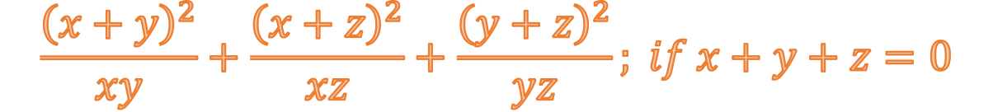
$$\frac{{\left(x+y\right)}^{2}}{xy}+\frac{{\left(x+z\right)}^{2}}{xz}+\frac{{\left(y+z\right)}^{2}}{yz}; if x+y+z=0$$
$\frac{x^{2}+y^{2}}{xy}+2+\frac{x^{2}+z^{2}}{xz}+2+\frac{y^{2}+z^{2}}{yz}+2=$
$\frac{x}{y}+\frac{yx}{x}+2+\frac{x}{z}+\frac{z}{x}+2+\frac{y}{z}+\frac{z}{y}+2=$
$\frac{y+z}{x}+\frac{x+z}{y}+\frac{x+y}{z}+6=\frac{−x}{x}+\frac{−y}{y}+\frac{−z}{z}+6 = −3+6 = 3$

Slide 12

$$a+2ab+b=22; in integers$$
$2a+4ab+2b+1=22∗2+1=45$
nab+1 factorize trick :
$a+nab+b=na+n^{2}ab+nb+1−1=\left(na+1\right)(nb+1)−1$
$\left(2a+1\right)(2b+1)=45=9∗5=3∗15$
a,b = (1,7) or (2,4)

Slide 13
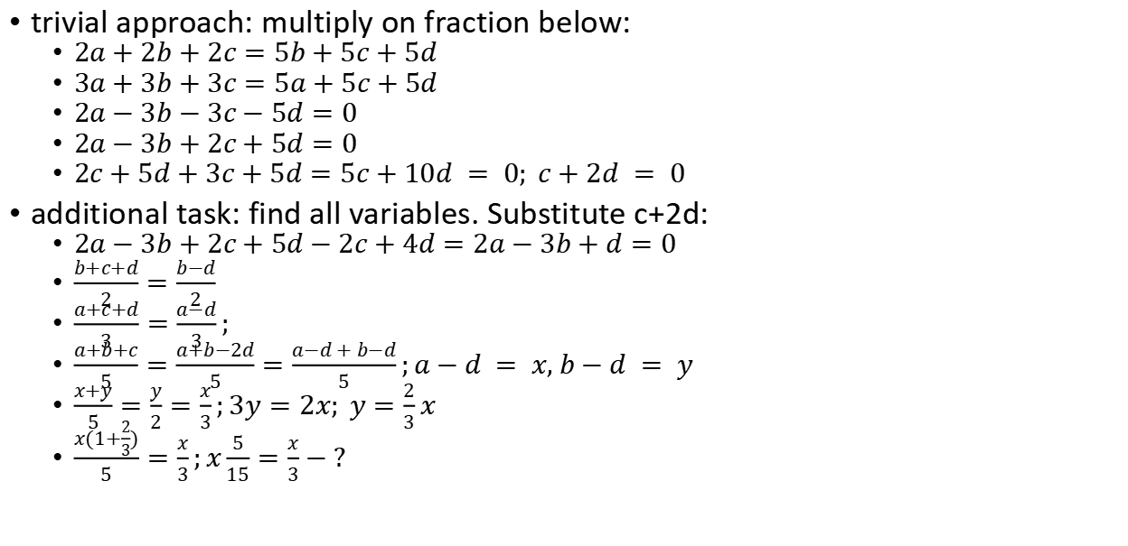
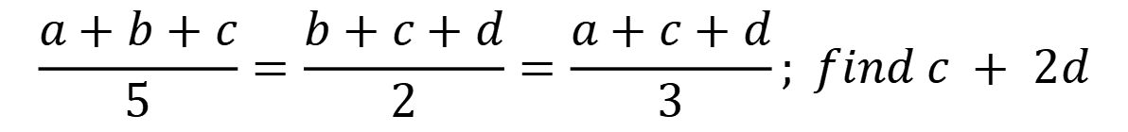
$$\frac{a+b+c}{5}=\frac{b+c+d}{2}=\frac{a+c+d}{3}; find c + 2d$$
trivial approach: multiply on fraction below:
$2a+2b+2c=5b+5c+5d$
3$a+3b+3c=5a+5c+5d$
$2a−3b−3c−5d=0$
$2a−3b+2c+5d=0$
$2c+5d+3c+5d=5c+10d = 0; c+2d = 0$
additional task: find all variables. Substitute c+2d:
$2a−3b+2c+5d−2c+4d=2a−3b+d=0$
$\frac{b+c+d}{2}=\frac{b−d}{2}$
$\frac{a+c+d}{3}=\frac{a−d}{3};$
$\frac{a+b+c}{5}=\frac{a+b−2d}{5}=\frac{a−d + b−d}{5};a−d = x, b−d = y$
$\frac{x+y}{5}=\frac{y}{2}=\frac{x}{3};3y=2x; y=\frac{2}{3}x$
$\frac{x(1+\frac{2}{3})}{5}=\frac{x}{3};x\frac{5}{15}=\frac{x}{3}−?$

Slide 14


$$\sqrt{x+1}−\sqrt{\frac{x−1}{x}}=1$$
square both parts:
$x+1−2\sqrt{\frac{x^{2}−1}{x}}+\frac{x−1}{x}=1$
$x−\frac{1}{x}−2\sqrt{x−\frac{1}{x}}+1=0$
substitute$\sqrt{x−\frac{1}{x}}=t ≥ 0$
${\left(t−1\right)}^{2}=0$
$x−\frac{1}{x}=1$
$x=\frac{1±\sqrt{5}}{2}$

